Slide 1
WebAssembly and Blazor – the future of frontend development?
Krzysztof Kalinowski
Senior .NET Developer at Making Waves
https://kkalinowski.net
https://github.com/kkalinowski

Slide 2
Before WebAssembly
WebAssembly
Future of WebAssembly
Blazor as a WebAssembly framework
Possiblities of Blazor
Summary

Slide 3
Disclaimer
I’m a backend developer and I don’t really like JavaScript
Most of the technologies presented are in development and may change

Slide 4
History of attempts to replace JavaScript
90s and beginning of 2000s JavaScript was used mostly for the basic interactivity on web pages
Plugins were popular for rich web applications, most notable:
Flash - 1996 - 2020
Java applets - 1995 – 2017
Silverlight - 2007 – 2021
With time market share of all of these plugins dropped

Slide 5
Why web plugins lost their importance
Owned by big companies, that mainly wanted to earn money
Wasn’t really a part of website – walled garden of iframe
Too big and unstable to become a standard
Required additional virtual machine on top of JavaScript virtual machine
You could only run language envisioned by plugin creators
Poor security
Wasn’t supported on mobile platforms

Slide 6
After plugins stopped being important
Focus on JavaScript
New versions of language
Transpiler target
Better tooling
JavaScript on server, desktop and mobile
Better browsers
JavaScript become monopolist when it comes to frontend development. People discuss only frontend framework choices.
Still not enough performance for heavy-duty tasks like games, modeling or generally software that works on large amounts of data

Slide 7
asm.js
Created by Mozilla in 2013
Subset of Javascript
Focus on performance
asm.js depends on type consistency and no garbage collection
Emscripten compiler allows to compile C program to asm.js version of Javascript
Browser creators incorporated further optimizations
Example software running on asm.js include Unreal Engine, Unity, SQLite, DosBox

Slide 8
WebAssembly (WASM)
Open web standard created by W3C with engineers from Mozilla, Microsoft, Google and Apple in 2015
Binary format for executable code in web pages
Also supports human readable text representation
Is stack based
Nearly native performance
Run in sandbox for security
Based on feature set of asm.js
asm.js can be used as a polyfill

Slide 9
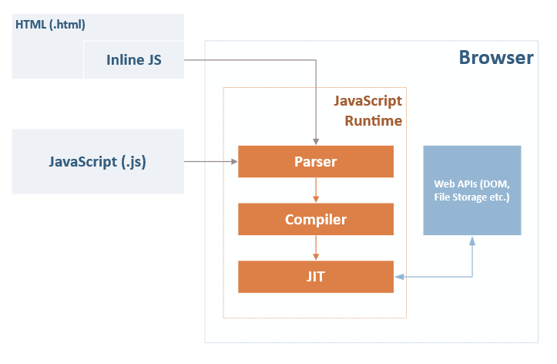
Inner workings of JavaScript
Image from https://daveaglick.com/posts/blazor-razor-webassembly-and-mono

Slide 10
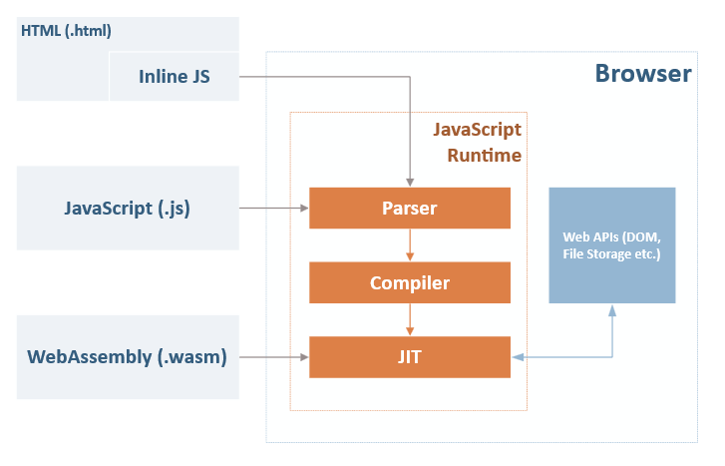
Inner workings of WebAssembly
Image from https://daveaglick.com/posts/blazor-razor-webassembly-and-mono

Slide 11
WASM under the hood - DEMO
https://mbebenita.github.io/WasmExplorer/
Notes:
https://mbebenita.github.io/WasmExplorer/
int add(int a, int b) { return a + b;}
Pokaże wam teraz jak wyglądają bebechy WebAssembly. W tym celu użyję strony stworzonej przez programistów z Mozilli – gdzie w latwy sposób można przekompilować sobie kod napisany w C na binarą postać wasm. Użyję prostę funkcji do dodawania dwóch liczb. W prawej zakładce widać skompilowany binarny kod. W środkowej zakładce macie kod skompilowany do specjalnego formatu czytelnego dla ludzi widać w nim deklarację nowej funkcji i użycie metod do operacji na intach. Ten kompilator zawiera też kilka przykładów bardziej zaawansowanych funkcji, jak np. qsort.

Slide 12
Created with WebAssembly
More on https://github.com/mbasso/awesome-wasm
https://web.autocad.com/ - fully functional AutoCAD
http://aws-website-webassemblyskeletalanimation-ffaza.s3-website-us-east-1.amazonaws.com/ - WASM used for animation
https://d2jta7o2zej4pf.cloudfront.net/ - WASM used for video editor
https://wasmboy.app/ - GameBoy emulator
https://jpmorganchase.github.io/perspective/ - WASM used to dispaly realtime financial data
Notes:
DEMO

Slide 13
Current state of WebAssembly - MVP
All major browsers support it
85.5% users browsers support WebAssembly - https://caniuse.com/#feat=wasm
Supports basic numeric types and functions, interaction with memory

Slide 14
WebAssembly roadmap
Based on https://hacks.mozilla.org/2018/10/webassemblys-post-mvp-future/
Host bindings (ability to interact with DOM)
Garbage collector
Threads + SIMD (already in Chrome)
Exception handling
Debugging

Slide 15
Further roadmap
Based on https://hacks.mozilla.org/2018/10/webassemblys-post-mvp-future/ and my opinions
Run on every device and use its APIs (WASI standard)
Ability to present possible APIs to call from WASM package
Npm-like repository of packages compiled to WebAssembly (community already created https://wapm.io/)
Ability to run on every device and use packages regardless of the language they were created in and libraries they use

Slide 16
Riscs to WebAssembly
Not substential, but
Still in development
Browser adoption
Security

Slide 17
WebAssembly vs web plugins
Open standard vs propretiary solution
Part of the website vs iframe
Minimal vs big and bloated
Any language compiled to WASM vs language envisioned by plugin creators
Sandboxed vs poor security
Supported on mobile vs not

Slide 18
Frameworks and compilers supporting WebAssembly
From https://github.com/appcypher/awesome-wasm-langs
C/C++
Emscripten
Cheerp
Go
Java
TeaVM
JWebAssembly
Bytecoder
Kotlin
Perl
PHP
Python
Ruby
Rust
Yew
and more…

Slide 19
.NET supporting WebAssembly
Mono as a compiler
Ooui - https://github.com/praeclarum/Ooui
Platform Uno - https://platform.uno/
Blazor - https://blazor.net/
Notes:
DEMO
Platform.uno - xaml na mobilki, desktopa i www, ma wspierać silverlighta

Slide 20
Blazor

Slide 21
About Blazor
Frontend framework for .NET that leverages WebAssembly to create rich, modern web SPA
Created by creator of Knockout.js - Steve Sanderson
Blazor = Browser + Razor
Uses Razor syntax familiar to ASP.NET MVC developers
Component system
Two-way binding
Javascript Interop
Event handling
Dependency injection
Routing
Lifecycle methods
Forms and validation
Limited debugging
Can be run stand-alone or with ASP.NET Core backend

Slide 22
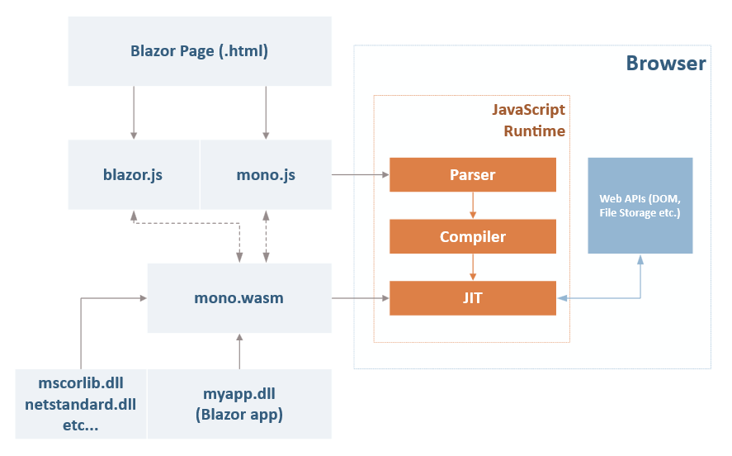
Inner workings of Blazor

Slide 23
Blazor prerequisites
Visit https://blazor.net
.NET Core 3.0 SDK
Visual Studio 2019
Blazor Language Services extension

Slide 24
Blazor demo
Notes:
Projekt blazor + todo + generated data from lib12 api
Logika zapisana jest w sekcji @functions{}
Metody typu OnInit (+async) do lifecycle’u

Slide 25
Created by Blazor community
More on https://github.com/AdrienTorris/awesome-blazor
Lot of examples - https://lupblazordemos.z13.web.core.windows.net/
Bootstrap for Blazor - https://github.com/chanan/BlazorStrap
Google’s Material for Blazor - https://github.com/BlazorExtensions/BlazorMaterial
Redux store - https://github.com/torhovland/blazor-redux
Telerik UI for Blazor - https://www.telerik.com/blazor-ui
Notes:
DEMO

Slide 26
Server side Blazor
Client app is executed on the server
All user interaction in browser are transported via SignalR to server, which then executes client logic and transports back DOM updates
Change between server-side / client-side will be one line of code

Slide 27
Server side Blazor
Pros:
Browser doesn’t have to support WebAssembly to run this
App download size is significantly smaller
Useful for clients with limited resources
You can use server APIs on client side like IO
More secure – all source code stays on the server
Cons:
No offline suport
Latency
Need better server hardware – server must manage multiple client connections and handle client state

Slide 28
Blazor-Electron
Run Blazor app inside of Electron shell
Could allow to finally bring possibility to create cross platform desktop applications in .NET
Sample by Steve Sanderson - https://github.com/SteveSandersonMS/BlazorElectronExperiment.Sample

Slide 29
Strongly typed APIs
Emitting strongly typing C# code from TypeScript definition files
Thanks to OpenAPI/Swagger support in ASP.NET Core 2.2 you’ll be able to access REST APIs in strongly-typed way
So – all that before was loosely typed and/or used magic strings will be strongly typed and available via IntelliSense

Slide 30
Future of Blazor
Full debugging in browsers and in the IDE
Polyfill via asm.js
Live reload
PWA support
Real-time data thanks to SignalR

Slide 31
Riscs to Blazor
WebAssembly may not deliver
File size – larger than js (you download pretty much whole runtime)
Mitigated by tree shaking and caching
Performance – vanilla.js is faster
Mitigated by AOT compilation and improvements in WASM itself

Slide 32
What Blazor is not
Transpiled C# - you have whole .NET on frontend
Silverlight – you don’t need any plugin installed, it works on mobile!
WebForms – it doesn’t try to work around web standards, it uses them

Slide 33
Blazor as part of .NET Core 3
Release date - September 2019
First version – only server-side, client-side some time later
Change to client-side will be one line of code

Slide 34
How should I use Blazor?
Strictly my opinion
Current version already supports a lot of stuff – try it for some side projects
When .NET Core 3 with Server-side Blazor will be available later this year you can use it in smaller non critical projects taking into account its disadvantages
When WebAssembly becomes popular and implement most needed features Blazor should be mature framework ready to use in any project – my guess 2020

Slide 35
Summary

Slide 36
WebAssembly
Binary format of executable code for web and possibly other environments
Currently MVP, but has bright future
Supported by all browsers and many language creators
In my opinion has prospects to dramatically change our day-to-day work

Slide 37
Blazor
Frontend framework using WebAssembly that allows you to create rich interactive web pages (and possibly more) using only C#
Still in development, but has bright future
Simplifies a lot of development

Slide 38
Should I learn WebAssembly?
Not unless you are writing a compiler or want to use WASM for performance gains in js code
But it’s good to know how it works underneath

Slide 39
Business case
I need less developers with smaller skillset
I can share code across more environments
I can developed in language safer than JavaScript
I can use new modern technologies to write code faster

Slide 40
Will WebAssembly replace JavaScript?
Quoting WASM creators – „No! WebAssembly is designed to be a complement to, not replacement of, JavaScript.” - https://webassembly.org/docs/faq/
In my opinion no, but:
It won’t happen in near future, WASM is still a MVP, there is a lot of work to be done on browsers, compilers and framework creators
There is a lot of source code written in js – it’s need to be maintaned
Some people just prefer js
But WASM gives choice, you want have to create frontend code in Javascript and in coming years many people won’t choose Javascript, so it’s naturally that js popularity will decline

Slide 41
Links
This presentation – https://github.com/kkalinowski/Wasm-Blazor-Presentation
Post MVP WebAssembly - https://hacks.mozilla.org/2018/10/webassemblys-post-mvp-future/
Blazor main page - https://blazor.net/
Awesome Blazor - https://github.com/AdrienTorris/awesome-blazor
Awesome WASM - https://github.com/mbasso/awesome-wasm

Slide 42
Q&A

